Slide 1
Programming Standards
Java 2
Object Oriented Programming Essentials CPRG 251

Slide 2
Introduction
Adhering to proper standards in programming, such as naming conventions, program format etc., makes writing and maintaining programs easier.
Documentation requires description of all code.
At the conclusion of this segment you will be able to write programs using standard style and naming conventions
Object Oriented Programming Essentials CPRG 251

Slide 3
Agenda
  Naming Conventions (5 minutes)
  Program format (5 minutes)
  Comments (5 minutes)
Object Oriented Programming Essentials CPRG 251

Slide 4
Overview
Naming conventions deal with standards to create proper names for different components of a java program
Program format defines how lines of code in a program are physically arranged
Comments are used to clarify segments of code (note: properly written code is somewhat self documenting)
Object Oriented Programming Essentials CPRG 251

Slide 5
Naming Conventions
All names must be meaningful and relate to the component described
qxy as a variable name may be valid but is not meaningful
studentName although longer is meaningful (does it need a comment to describe what it is?)
Object Oriented Programming Essentials CPRG 251

Slide 6
Naming Conventions
Classes
  begin with capital letter
  each new word there after is capitalized
  noun oriented
  example: CardReader
Object Oriented Programming Essentials CPRG 251

Slide 7
Naming Conventions
Packages
  begin with lower case
  each new word there after is capitalize
  example: fileHandling
Object Oriented Programming Essentials CPRG 251

Slide 8
Naming Conventions
Methods
  begin with lower case
  each new word there after is capitalize
  verb object
  example: makeDeposit
  Good idea to start with the verb
Object Oriented Programming Essentials CPRG 251

Slide 9
Naming Conventions
Variables (class instance)
  begin with lowercase
  each new word thereafter is capitalized
  noun oriented
  example: validWord
Object Oriented Programming Essentials CPRG 251

Slide 10
Naming Conventions
Constants
  all letters capitalized
  words separated by an underscore: _
  example: MAXIMUM_LENGTH
Object Oriented Programming Essentials CPRG 251
Notes:
2003/5/23
Assignment 1 set 1

Slide 11
Program Format
Class / Method headers
  class and method definitions will be the only entry on a line
  example:
    acceptable:
    public class Planet
    not acceptable:
    public class Planet {
Object Oriented Programming Essentials CPRG 251
Notes:
2003/5/23
Assignment 1 set 1

Slide 12
Program Format
Statement
  only one statement per line
  longer statements may occupy more than one line
  double-spacing is optional
Object Oriented Programming Essentials CPRG 251

Slide 13
Programming format
Blocks of Code
  start and end with { }
  starting and ending {} are only entry on a line
  body of block indented
  starting and ending {} align
  nested blocks are permitted (no more than 3 deep)
Object Oriented Programming Essentials CPRG 251

Slide 14
Program Standards
Programs must be accompanied by appropriate UML diagrams or Javadoc documentation
Minimum of class diagram
Diagrams will follow UML standards
Object Oriented Programming Essentials CPRG 251

Slide 15
Program Comments
Comments can be divided into two categories
  Implementation comments
    Describes how the code works
  Documentation comments
    Describes what the code does and how to use it
    JavaDoc
    Java APIs
Object Oriented Programming Essentials CPRG 251

Slide 16
Program Comments
All programs must have appropriate comments
  Both implementation and documentation
Object Oriented Programming Essentials CPRG 251

Slide 17
Implementation Comments
Similar to those in C or C++
  Block comments delimited by /* …*/
  In-line // line or rest of line is treated as a comment
Object Oriented Programming Essentials CPRG 251

Slide 18
Implementation Comments
/*
* This class contains information about a planet. Upon creation of an
* instance of this class the radius and the density must be provided. From an
* instance of this class the planet's radius, density, volume and mass can
* be obtained.
*
* Date Written 10 Oct 2000
* Author Sharon Hoiland
*/
Object Oriented Programming Essentials CPRG 251

Slide 19
Implementation Comments
public double getVolume()
{
// calculates the value of the volume and returns it
// System.out.println((4.0 / 3.0) * Math.PI * Math.pow(radius, 3));
return (4.0 / 3.0) * Math.PI * Math.pow(radius, 3);
}
Object Oriented Programming Essentials CPRG 251

Slide 20
Documentation Comments
Creates documentation showing how to use a method
Delimited by /** …. */
Has key tags starting with @
Object Oriented Programming Essentials CPRG 251

Slide 21
Documentation Comments
Tags
  @ param (explain the parameters)
  @ return (explain the return values)
  @ author (probably put at top)
  @ version (show version of code, eg. Version 1)
  @ throws (to show what exceptions you threw)
Object Oriented Programming Essentials CPRG 251
Notes:
GetHop?? To handle different versions of your code (called a repository).
2003/5/23
Assignment 1 set 1

Slide 22
Documentation Comments
/**
* Constructor assigns values for radius and density of a planet.
*
* @param rad a double for the planet's radius in meters
* @param dens a double for the planet's density in kg/m3
*/
public Planet (double rad, double dens)
{
radius = rad;
density = dens;
}
Object Oriented Programming Essentials CPRG 251

Slide 23
Documentation Comments
javadoc
Command to create javadoc
  javadoc [options] source files
  javadoc –author –version *.java
Viewed using a web browser
Creates a series of html files that may be viewed in a web browser
Same format as the Java APIs
Object Oriented Programming Essentials CPRG 251

Slide 24
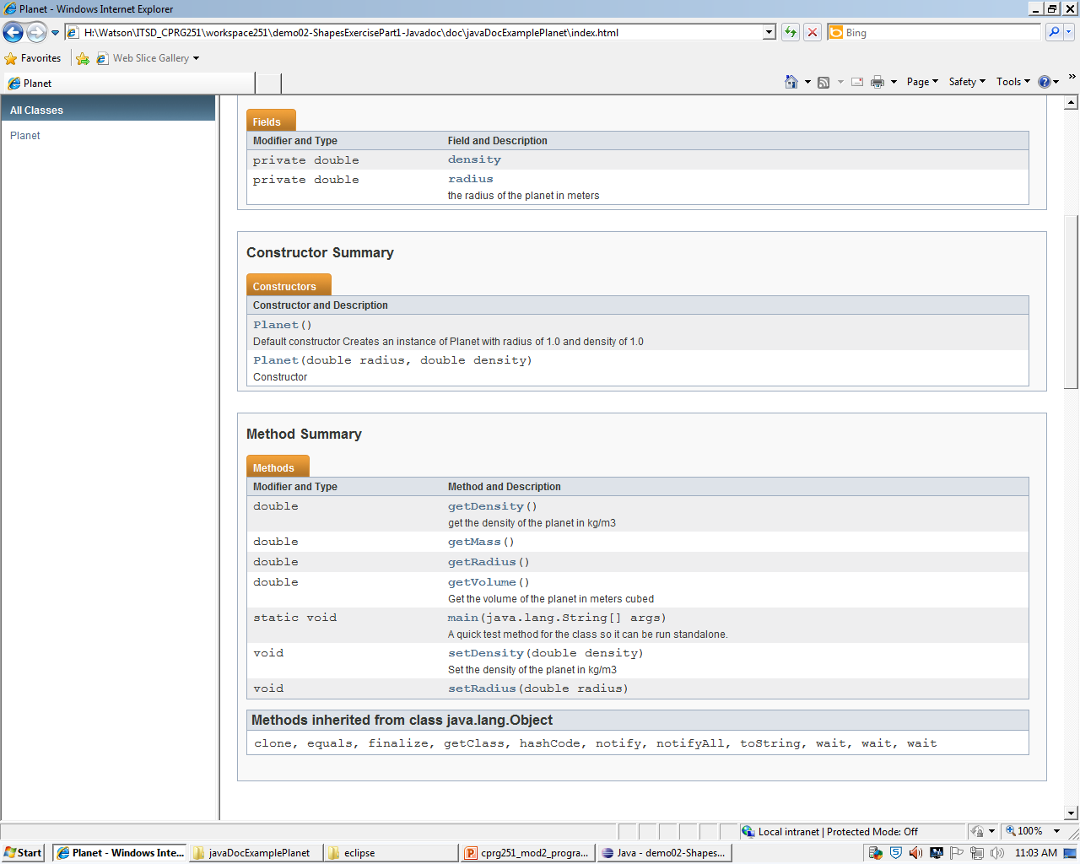
Documentation Comments
Object Oriented Programming Essentials CPRG 251

Slide 25
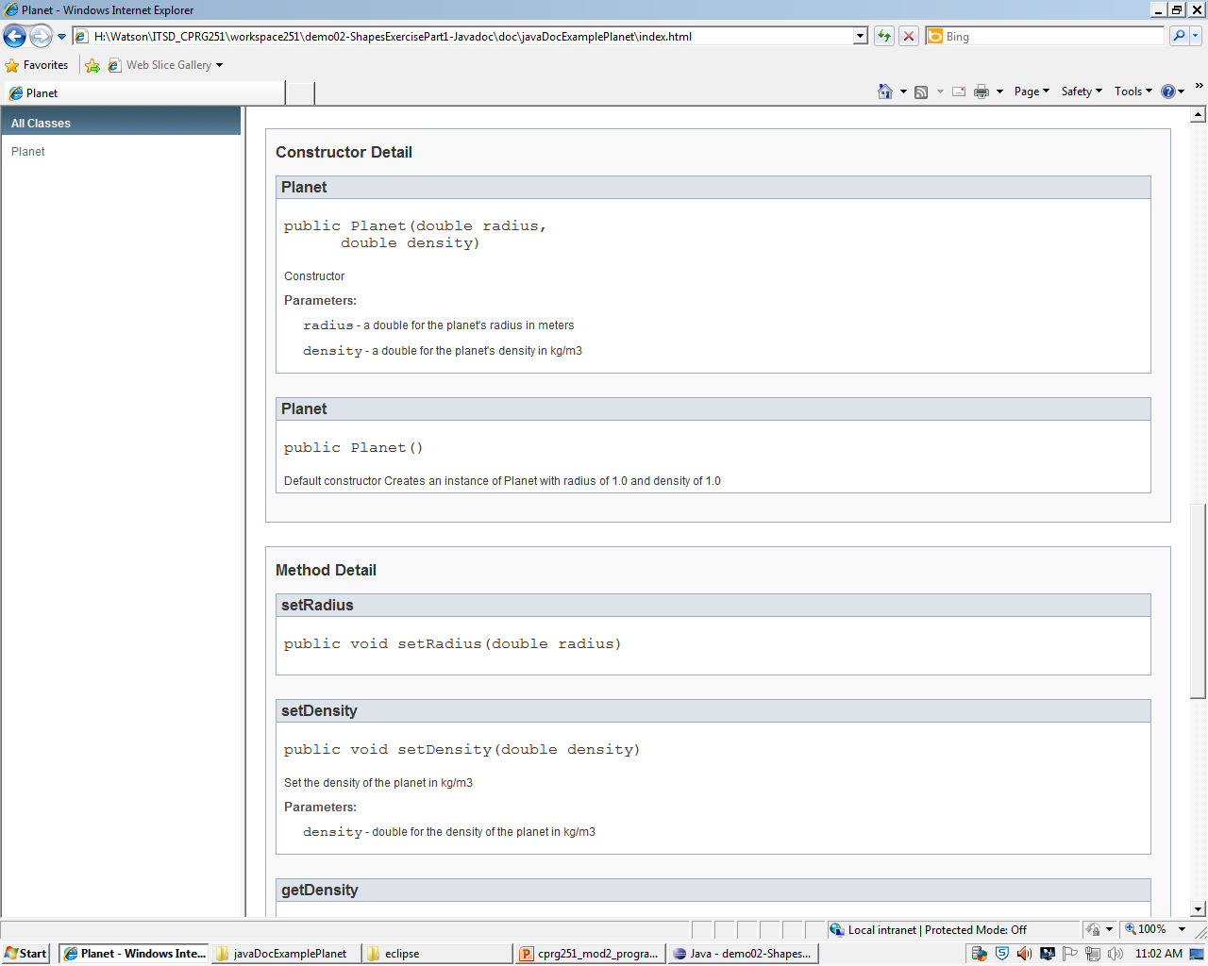
Documentation Comments
Object Oriented Programming Essentials CPRG 251

Slide 26
Exercise
Use Planet.java to demonstrate javadoc
Object Oriented Programming Essentials CPRG 251

Slide 27
Java Archive (JAR)files
Platform independent
File compression
Used for distribution of applications and applets
Uses ZIP format
Object Oriented Programming Essentials CPRG 251

Slide 28
JAR command
jar options filename [input files]
Example:
  jar cf myfiles.jar *
    Compresses all files in the current directory and places them in a file named myfiles.jar
  jar xf myfiles.jar
    Expands the files in myfiles.jar into the current directory
  jar tf myfiles.jar
    Lists all files in myfiles.jar
Object Oriented Programming Essentials CPRG 251
Notes:
The jar engine
2003/5/23
Assignment 1 set 1

Slide 29
Executable Jar File
An executable jar file can be executed directly from the java virtual machine
Requires that the class containing the main method be specified using a manifest file containing the line (name it manifest.mf):
MAIN-CLASS: AppDriver
Creation:
jar –cvmf manifest.mf jarfileName.jar *
Execution:
java –jar jarfileName.jar
Object Oriented Programming Essentials CPRG 251
Notes:
manifest.mf
Use cmd to run because don’t have GUI
If you don’t want to use cmd
-new file RUN.bat
-java –jar myJar.jar (enter this into the file)
-then when you double click on run it will run your code
2003/5/23
Assignment 1 set 1

Slide 30
Creation of an executable JAR
Create all java files in scr directory
Create a manifest file
  A manifest file is a text file
  Among other things specifies the location of the main method
Object Oriented Programming Essentials CPRG 251

Slide 31
Summary
Use proper naming convention
Use proper program format
Use proper documentation
Object Oriented Programming Essentials CPRG 251

Slide 32
Where to Get More Information
Big Java
  Chapter 3, pages 90-93
  Appendix A, pages 634-636
  Appendix J, pages 1133-1135
CT Documentation and Coding Standards
Object Oriented Programming Essentials CPRG 251

